Slide 1
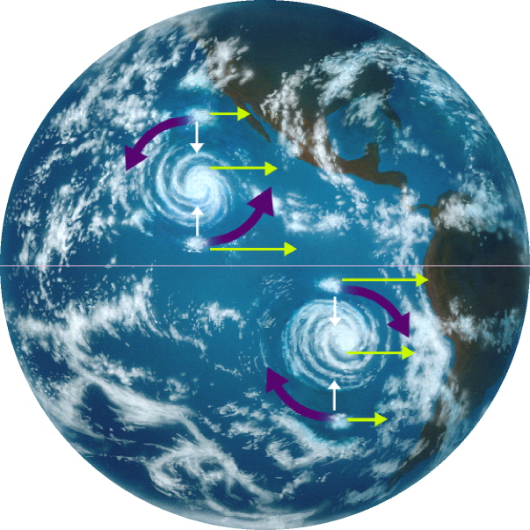
Lecture 4 – Coriolis Force and its effects
Chapter 8 or 9
Non-inertial frames &
Fictitious forces
Page no. 355 to 367
..\..\..\..\2019-20 I sem\videos for lecture 2019\The Coriolis Effect.wmv

Slide 2
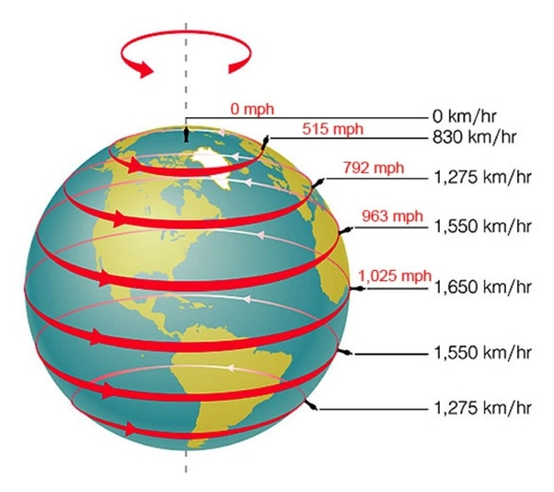

Slide 3

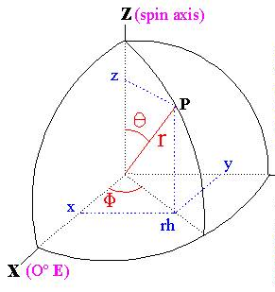
Coriolis force due to earth’s rotation
Local vertical

Slide 4
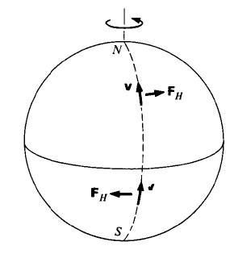
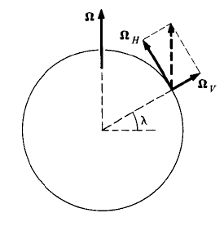
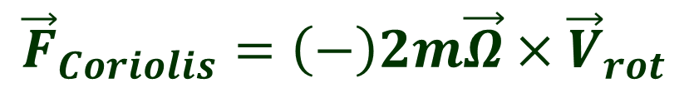
Coriolis force due to earth’s rotation
$${\vec{F}}_{Coriolis}=\left(−\right)2m\vec{Ω}×{\vec{V}}_{rot}$$

Slide 5
Non-intuitive behavior in accelerating frames
..\..\..\..\2020-21 I sem\Mechanics 2020\Lecture videos\train coriolis2.mp4
..\..\..\..\2020-21 I sem\Mechanics 2020\Lecture videos\train coriolis1.mp4
..\..\..\..\2020-21 I sem\Mechanics 2020\Lecture videos\coriolis 2.mp4
C:\Users\admin\Documents\BITS Teaching New\2020-21 I sem\Mechanics 2020\Lecture videos\Coriis1.mp4

Slide 8
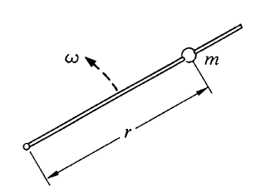
Example – 1 – Bead sliding on a rotating frictionless rod
F_{inertial} = 0
F_{inertial} = 0
Forces in inertial Frame:
F_{non-inertial} = 0
Forces in non-inertial Frame:
Notes:
In inertial frame only forces that are acting is in the theta cap direction, ie the normal force.

Slide 9
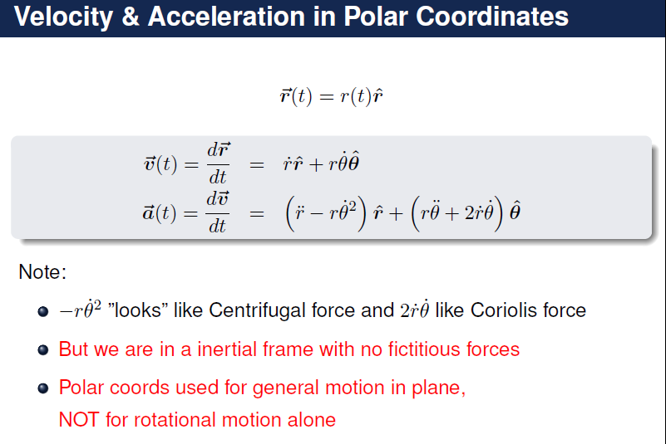
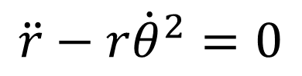
Example – 1 – Bead sliding on a rotating rod
In Inertial frame:
Force along radial direction is zero
$$\ddot{r}−r{\dot{θ}}^{2}=0$$
In Inertial frame:
Force along tangential direction is the normal force

Slide 10
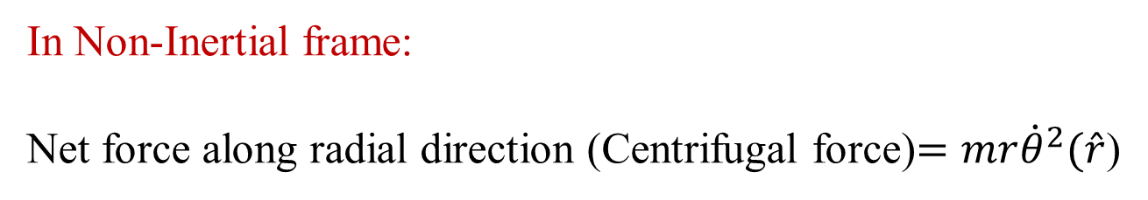
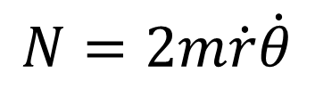
Example – 1 – Bead sliding on a rotating rod
In Non-Inertial frame:
Net force along tangential direction is zero
$$Normal Force=Coriolis Force$$
$$N=2m\dot{r}\dot{θ}$$
In Non-Inertial frame:
Net force along radial direction (Centrifugal force)$=mr{\dot{θ}}^{2}(\hat{r}$)

Slide 11
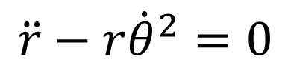
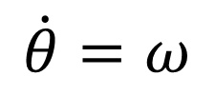
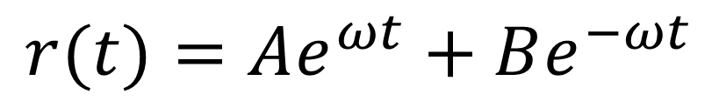
Example – 2 – Bead sliding on a rotating rod
$$\ddot{r}−r{\dot{θ}}^{2}=0$$
The solution is
$$r(t)=Ae^{ωt}+Be^{−ωt}$$
$$\dot{θ}=ω$$
Depending upon the initial conditions, the radius will either increase or decrease as a function of time.

Slide 12
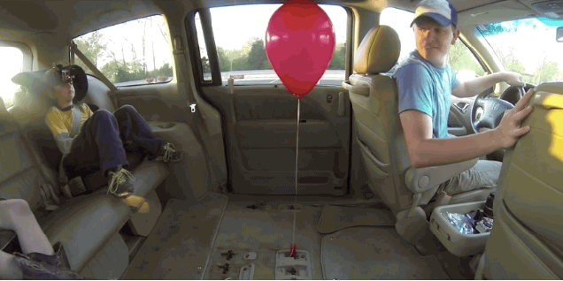
Motion of He Filled Balloon in non-inertial frame

Slide 13
